Slide 1



377 Operating Systems
Join on Zoom if you are remote (see website for link).
Multi-Level Feedback Queue (MLFQ)

Slide 2

You can’t have your cake and eat it too!
But, is there a way we can have at least half?

Slide 3
Workload Assumptions
First, we want to make some simplifying assumptions about running processes This is typically referred to as the workload.
Simplified assumptions about running processes (often called jobs):
Each job runs for the same amount of time
All jobs arrive at the same time
Once started, each job runs to completion
All jobs only use the CPU (i.e., no I/O)
The run-time of each job is known

Slide 4
Incorporating I/O
Of course, all interesting programs perform some kind of I/O.
A scheduler clearly has to make a decision
If an I/O request is made, the scheduler doesn't want to block other jobs.
If the I/O is sent to a hard disk drive, the process might be blocked for a few milliseconds or longer, depending on the current I/O load of the drive.
The scheduler should probably schedule another job on the CPU at that time.

Slide 5
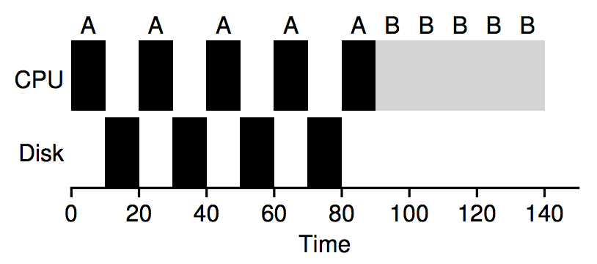
I/O Example
To understand this issue better, let us assume we have two jobs, A and B, which each need 50 ms of CPU time. However, there is one obvious difference: A runs for 10 ms and then issues an I/O request (assume here that I/Os each take 10 ms), whereas B simply uses the CPU for 50 ms and performs no I/O. The scheduler runs A first, then B after.

Slide 6
I/O Example
This is a poor use of resources!
To understand this issue better, let us assume we have two jobs, A and B, which each need 50 ms of CPU time. However, there is one obvious difference: A runs for 10 ms and then issues an I/O request (assume here that I/Os each take 10 ms), whereas B simply uses the CPU for 50 ms and performs no I/O. The scheduler runs A first, then B after.

Slide 7
I/O Example
This is a poor use of resources!
Assume we are trying to build a STCF scheduler. How should such a scheduler account for the fact that A is broken up into 5 10-ms sub-jobs, whereas B is just a single 50-ms CPU demand? Clearly, just running one job and then the other without considering how to take I/O into account makes little sense.

Slide 8
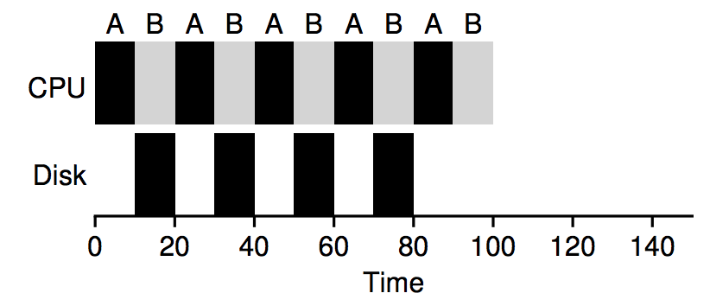
I/O Example
A common approach is to treat each 10-ms sub-job of A as an independent job. Thus, when the system starts, its choice is whether to schedule a 10-ms A or a 50-ms B.

Slide 9
I/O Example
This is a better use of resources!
With STCF, the choice is clear: choose the shorter one, in this case A.
Then, when the first sub-job of A has completed, only B is left, and it begins running.
Then a new sub-job of A is submitted, and it preempts B and runs for 10 ms. Doing so allows for overlap, with the CPU being used by one process while waiting for the I/O of another process to complete; the system is thus better utilized.

Slide 10
I/O Example
This is a better use of resources!
And thus we see how a scheduler might incorporate I/O.
By treating each CPU burst as a job, the scheduler makes sure processes that are “interactive” get run frequently.
While those interactive jobs are performing I/O, other CPU-intensive jobs run, thus better utilizing the processor.

Slide 11
Workload Assumptions
First, we want to make some simplifying assumptions about running processes This is typically referred to as the workload.
Simplified assumptions about running processes (often called jobs):
Each job runs for the same amount of time
All jobs arrive at the same time
Once started, each job runs to completion
All jobs only use the CPU (i.e., no I/O)
The run-time of each job is known

Slide 12
Workload Assumptions
First, we want to make some simplifying assumptions about running processes This is typically referred to as the workload.
Simplified assumptions about running processes (often called jobs):
Each job runs for the same amount of time
All jobs arrive at the same time
Once started, each job runs to completion
All jobs only use the CPU (i.e., no I/O)
The run-time of each job is known

Slide 13

The Multi-Level Feedback Queue
The Multi-level Feedback Queue (MLFQ) scheduler was first described by Corbato et al. in 1962 in a system known as the Compatible Time-Sharing System (CTSS).
This work, along with later work on Multics, led the ACM to award Corbato its highest honor, the Turing Award. The scheduler has subsequently been refined throughout the years to the implementations you will encounter in some modern systems

Slide 14
The Problem MLFQ Tries to Solve
First, MLFQ would like to optimize turnaround time.
Unfortunately, the OS doesn’t generally know how long a job will run for, exactly the knowledge that algorithms like SJF (or STCF) require.
Second, MLFQ would like to make a system feel responsive to interactive users and thus minimize response time.
Algorithms like Round Robin reduce response time but are terrible for turnaround time.

Slide 15
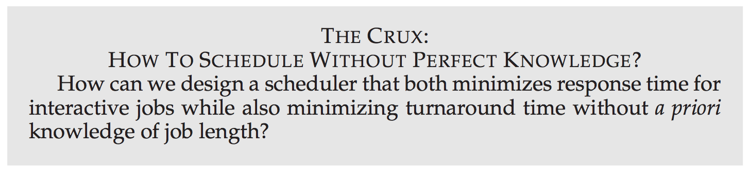

Slide 16
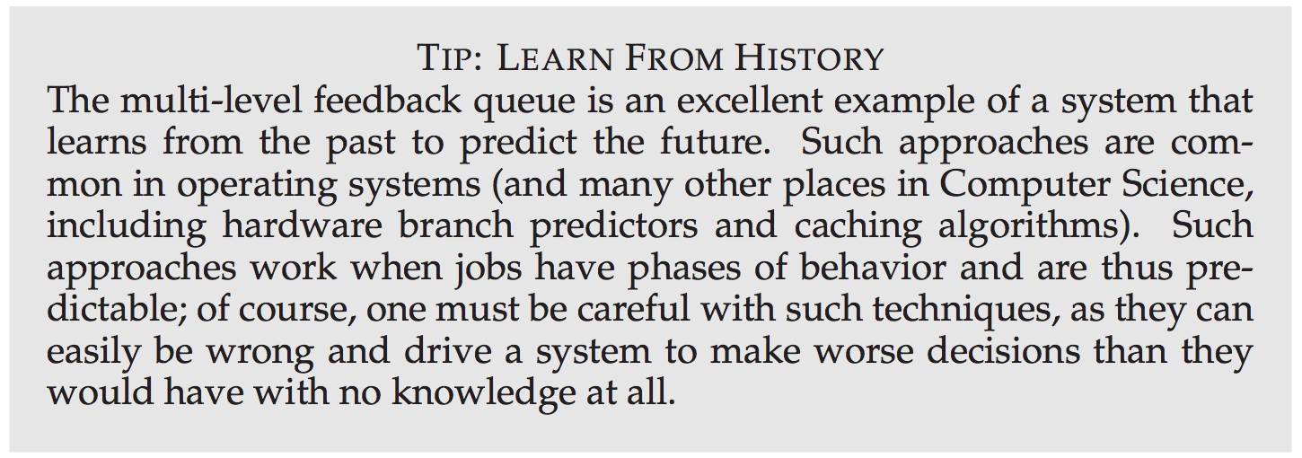

Slide 17

MLFQ: Basic Idea
In our treatment, the MLFQ has a number of distinct queues.
Each queue is assigned a different priority level. At any given time, a job that is ready to run is on a single queue.
MLFQ uses priorities to decide which job should run at a given time: a job with higher priority (i.e., a job on a higher queue) is chosen to run

Slide 18
MLFQ: Basic Rules
Of course, more than one job may be on a given queue, and thus have the same priority. In this case, we will just use round-robin scheduling among those jobs.
Thus, we arrive at the first two basic rules for MLFQ:
Rule 1: If Priority(A) > Priority(B), A runs (B doesn’t).
Rule 2: If Priority(A) = Priority(B), A & B run in RR.

Slide 19
MLFQ: Intuition
The key to MLFQ scheduling therefore lies in how the scheduler sets priorities. Rather than giving a fixed priority to each job, MLFQ varies the priority of a job based on its observed behavior.

Slide 20
MLFQ: Intuition
The key to MLFQ scheduling therefore lies in how the scheduler sets priorities. Rather than giving a fixed priority to each job, MLFQ varies the priority of a job based on its observed behavior.
If, for example, a job repeatedly relinquishes the CPU while waiting for input from the keyboard, MLFQ will keep its priority high, as this is how an interactive process might behave.

Slide 21
MLFQ: Intuition
The key to MLFQ scheduling therefore lies in how the scheduler sets priorities. Rather than giving a fixed priority to each job, MLFQ varies the priority of a job based on its observed behavior.
If, for example, a job repeatedly relinquishes the CPU while waiting for input from the keyboard, MLFQ will keep its priority high, as this is how an interactive process might behave.
If, instead, a job uses the CPU intensively for long periods of time, MLFQ will reduce its priority. In this way, MLFQ will try to learn about processes as they run, and thus use the history of the job to predict its future behavior.

Slide 22
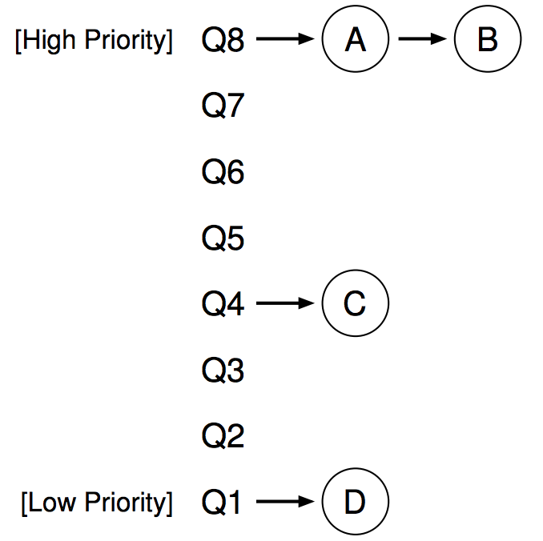
MLFQ: What does it look like?
In the figure, two jobs (A and B) are at the highest priority level, while job C is in the middle and job D is at the lowest priority.

Slide 23

MLFQ: What does it look like?
In the figure, two jobs (A and B) are at the highest priority level, while job C is in the middle and job D is at the lowest priority.
The scheduler would just alternate time slices between A and B because they are the highest priority jobs in the system; poor jobs C and D would never even get to run — an outrage!

Slide 24
MLFQ: What does it look like?
Of course, just showing a static snapshot of some queues does not really give you an idea of how MLFQ works.
What we need is to understand how job priority change over time.
That is exactly what we will do next.

Slide 25
Attempt #1: How to change priority
We now must decide how MLFQ is going to change the priority level of a job (and thus which queue it is on) over the lifetime of a job.

Slide 26
Attempt #1: How to change priority
We now must decide how MLFQ is going to change the priority level of a job (and thus which queue it is on) over the lifetime of a job.
To do this, we must keep in mind our workload: a mix of interactive jobs that are short-running (and may frequently relinquish the CPU), and some longer-running “CPU-bound” jobs that need a lot of CPU time but where response time isn’t important.

Slide 27
Attempt #1: How to change priority
We now must decide how MLFQ is going to change the priority level of a job (and thus which queue it is on) over the lifetime of a job.
To do this, we must keep in mind our workload: a mix of interactive jobs that are short-running (and may frequently relinquish the CPU), and some longer-running “CPU-bound” jobs that need a lot of CPU time but where response time isn’t important.
Here is our first attempt at a priority-adjustment algorithm:

Slide 28
Attempt #1: How to change priority
We now must decide how MLFQ is going to change the priority level of a job (and thus which queue it is on) over the lifetime of a job.
To do this, we must keep in mind our workload: a mix of interactive jobs that are short-running (and may frequently relinquish the CPU), and some longer-running “CPU-bound” jobs that need a lot of CPU time but where response time isn’t important.
Here is our first attempt at a priority-adjustment algorithm:
Rule 3: When a job enters the system, it is placed at the highest priority (the topmost queue).

Slide 29
Attempt #1: How to change priority
We now must decide how MLFQ is going to change the priority level of a job (and thus which queue it is on) over the lifetime of a job.
To do this, we must keep in mind our workload: a mix of interactive jobs that are short-running (and may frequently relinquish the CPU), and some longer-running “CPU-bound” jobs that need a lot of CPU time but where response time isn’t important.
Here is our first attempt at a priority-adjustment algorithm:
Rule 3: When a job enters the system, it is placed at the highest priority (the topmost queue).
Rule 4a: If a job uses up an entire time slice while running, its priority is reduced (i.e., it moves down one queue).

Slide 30
Attempt #1: How to change priority
We now must decide how MLFQ is going to change the priority level of a job (and thus which queue it is on) over the lifetime of a job.
To do this, we must keep in mind our workload: a mix of interactive jobs that are short-running (and may frequently relinquish the CPU), and some longer-running “CPU-bound” jobs that need a lot of CPU time but where response time isn’t important.
Here is our first attempt at a priority-adjustment algorithm:
Rule 3: When a job enters the system, it is placed at the highest priority (the topmost queue).
Rule 4a: If a job uses up an entire time slice while running, its priority is reduced (i.e., it moves down one queue).
Rule 4b: If a job gives up the CPU before the time slice is up, it stays at the same priority level.

Slide 31
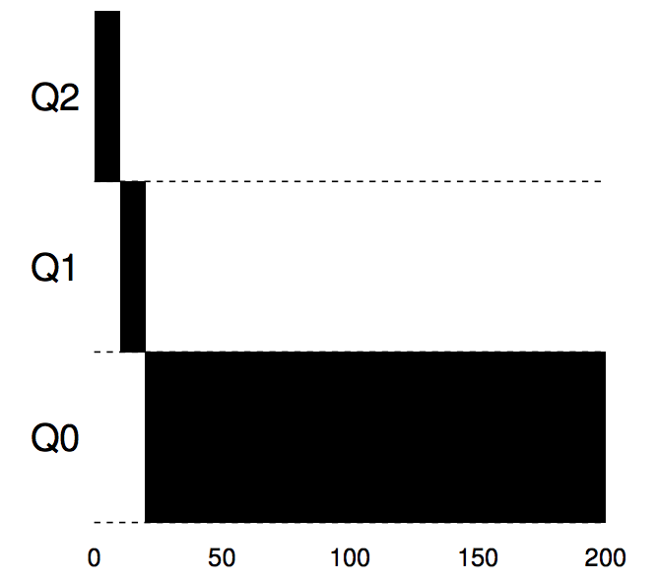
Example 1: A Single Long-Running Job
As you can see in the example, the job enters at the highest priority (Q2).
After a single time-slice of 10 ms, the scheduler reduces the job’s priority by one, and thus the job is on Q1.
After running at Q1 for a time slice, the job is finally lowered to the lowest priority in the system (Q0), where it remains. Pretty simple, no?

Slide 32
Example 2: Along Came a Short Job
Now let’s look at a more complicated example, and see how MLFQ tries to approximate SJF.
In this example, there are two jobs:
A, which is a long-running CPU-intensive job
B, which is a short-running interactive job.
Assume A has been running for some time, and then B arrives.
What will happen? Will MLFQ approximate SJF for B?

Slide 33
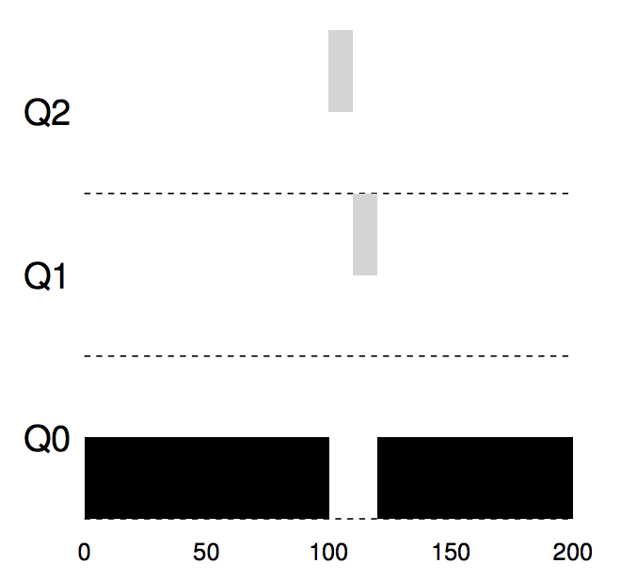
Example 2: Along Came a Short Job
A (shown in black) is running along in the lowest-priority queue (as would any long-running CPU-intensive jobs).
B (shown in gray) arrives at time T = 100, and thus is inserted into the highest queue; as its run-time is short (only 20 ms), B completes before reaching the bottom queue, in two time slices.
Then A resumes running (at low priority).

Slide 34
Example 2: Along Came a Short Job
You can hopefully understand one of the major goals of the algorithm:
because it doesn’t know whether a job will be a short job or a long-running job, it first assumes it might be a short job, thus giving the job high priority.
If it actually is a short job, it will run quickly and complete; if it is not a short job, it will slowly move down the queues, and thus soon prove itself to be a long-running more batch-like process. In this manner, MLFQ approximates SJF.

Slide 35
Example 3: What about I/O?
Let’s now look at an example with some I/O.
As Rule 4b states, if a process gives up the processor before using up its time slice, we keep it at the same priority level.
The intent of this rule is simple:
if an interactive job is doing a lot of I/O, it will relinquish the CPU before its time slice is complete
In such case, we wish not to penalize the job and thus simply keep it at the same level.

Slide 36
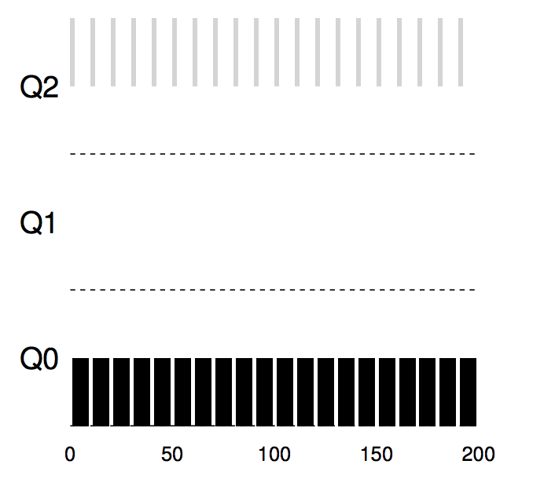
Example 3: What about I/O?
With an interactive job B (shown in gray) that needs the CPU only for 1 ms before performing an I/O competing for the CPU with a long-running batch job A (shown in black).
The MLFQ approach keeps B at the highest priority because B keeps releasing the CPU; if B is an interactive job, MLFQ further achieves its goal of running interactive jobs quickly

Slide 37
Example 3: What about I/O?
We thus have a basic MLFQ. It seems to do a good job, sharing the CPU fairly between long-running jobs, and letting short or I/O-intensive interactive jobs run quickly.
Unfortunately, the approach we have developed thus far contains serious flaws.
Can you think of any?

Slide 38
Example 3: What about I/O?
First, there is the problem of starvation.
If there are “too many” interactive jobs in the system, they will combine to consume all CPU time, and thus long-running jobs will never receive any CPU time (they starve).
We’d like to make some progress on these jobs even in this scenario.

Slide 39
Example 3: What about I/O?
Second, a smart user could rewrite their program to game the scheduler.
Gaming the scheduler generally refers to the idea of doing something sneaky to trick the scheduler into giving you more than your fair share of the resource.
How might you do this?

Slide 40
Attempt #2: The Priority Boost
Let’s try to change the rules and see if we can avoid the problem of starvation.
What could we do in order to guarantee that CPU-bound jobs will make some progress (even if it is not much?).
The simple idea here is to periodically boost the priority of all the jobs in system.
There are many ways to achieve this, but let’s just do something simple: throw them all in the topmost queue; hence, a new rule:
Rule 5: After some time period S, move all the jobs in the system to the topmost queue.

Slide 41
Attempt #2: The Priority Boost
Our new rule solves two problems at once.
First, processes are guaranteed not to starve: by sitting in the top queue, a job will share the CPU with other high-priority jobs in a round-robin fashion, and thus eventually receive service.
Second, if a CPU-bound job has become interactive, the scheduler treats it properly once it has received the priority boost.

Slide 42
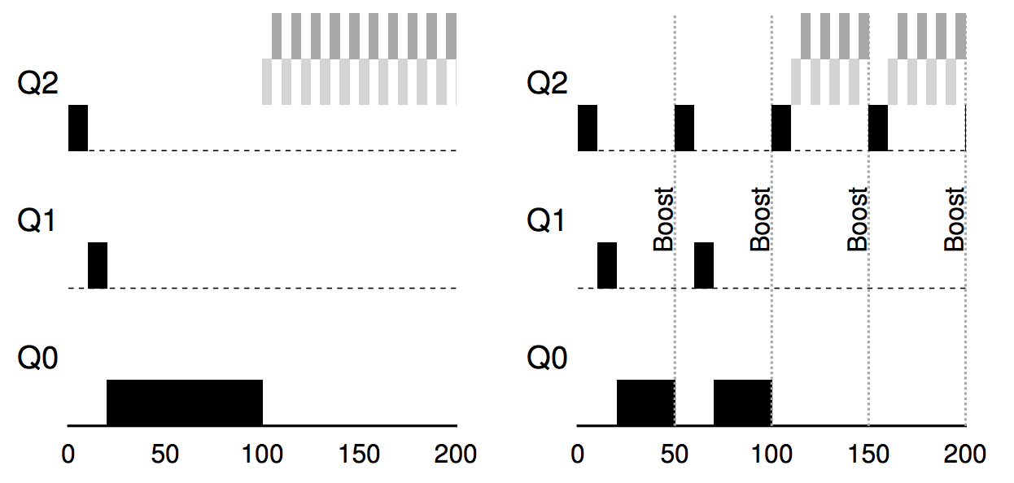
Attempt #2: The Priority Boost
In this example, we show the behavior of a long-running job when competing for the CPU with two short-running interactive jobs.

Slide 43
Attempt #2: The Priority Boost
On the left, there is no priority boost, and thus the long-running job gets starved once the two short jobs arrive.

Slide 44
Attempt #2: The Priority Boost
On the right, there is a priority boost every 50 ms, and thus we at least guarantee that the long-running job will make some progress, getting boosted to the highest priority every 50 ms and thus getting to run periodically

Slide 45
Attempt #2: The Priority Boost
John Ousterhout, a well-regarded systems researcher, used to call such values in systems voo-doo constants, because they seemed to require some form of black magic to set them correctly. Unfortunately, S has that flavor.
Of course, the addition of the time period S leads to the obvious question: what should S be set to? If it is set too high, long-running jobs could starve; too low, and interactive jobs may not get a proper share of the CPU.

Slide 46
Attempt #3: Better Accounting
We now have one more problem to solve: how to prevent gaming of our scheduler?
The real culprit here, as you might have guessed, are Rules 4a and 4b, which let a job retain its priority by relinquishing the CPU before the time slice expires.
So what should we do?

Slide 47
Attempt #3: Better Accounting
The solution here is to perform better accounting of CPU time at each level of the MLFQ. Instead of forgetting how much of a time slice a process used at a given level, the scheduler should keep track; once a process has used its allotment, it is demoted to the next priority queue. Whether it uses the time slice in one long burst or many small ones does not matter.
We thus rewrite Rules 4a and 4b to the following single rule:
Rule 4: Once a job uses up its time allotment at a given level (regardless of how many times it has given up the CPU), its priority is reduced (i.e., it moves down one queue).

Slide 48
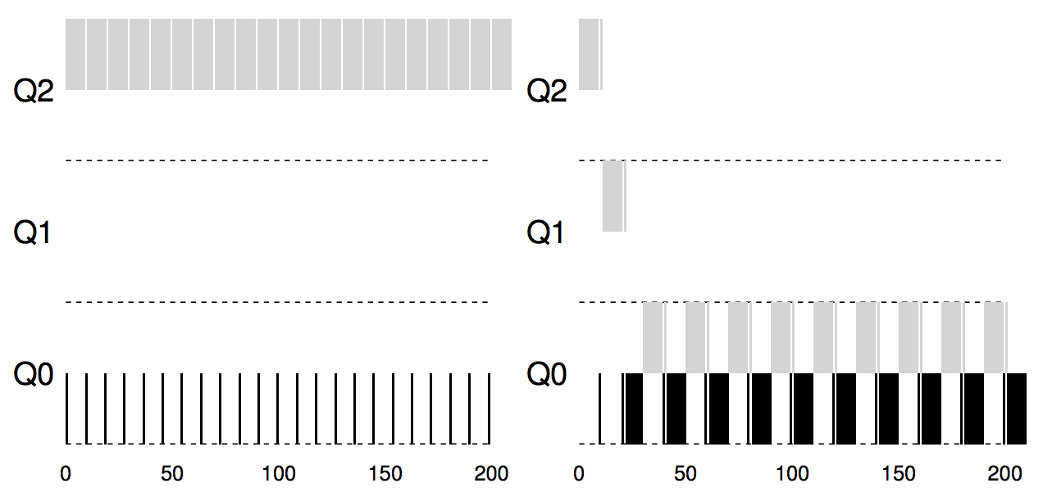
Attempt #3: Better Accounting
This example shows what happens when a workload tries to game the scheduler with the old Rules 4a and 4b (on the left) as well the new anti-gaming Rule 4.
With such protections in place, regardless of the I/O behavior of the process, it slowly moves down the queues, and thus cannot gain an unfair share of the CPU.

Slide 49
Case study: Linux Completely Fair Scheduler
https://en.wikipedia.org/wiki/Completely_Fair_Scheduler
The data structure used for the scheduling algorithm is a red-black tree in which the nodes are scheduler-specific sched_entity structures. These are derived from the general task_structprocess descriptor, with added scheduler elements.
The nodes are indexed by processor "execution time" in nanoseconds.^{[3]}
A "maximum execution time" is also calculated for each process. This time is based upon the idea that an "ideal processor" would equally share processing power amongst all processes. Thus, the maximum execution time is the time the process has been waiting to run, divided by the total number of processes, or in other words, the maximum execution time is the time the process would have expected to run on an "ideal processor".
When the scheduler is invoked to run a new process, the operation of the scheduler is as follows:
The leftmost node of the scheduling tree is chosen (as it will have the lowest spent execution time), and sent for execution.
If the process simply completes execution, it is removed from the system and scheduling tree.
If the process reaches its maximum execution time or is otherwise stopped (voluntarily or via interrupt) it is reinserted into the scheduling tree based on its new spent execution time.
The new leftmost node will then be selected from the tree, repeating the iteration.
If the process spends a lot of its time sleeping, then its spent time value is low and it automatically gets the priority boost when it finally needs it. Hence such tasks do not get less processor time than the tasks that are constantly running.

Slide 50

The End

